Slide 2
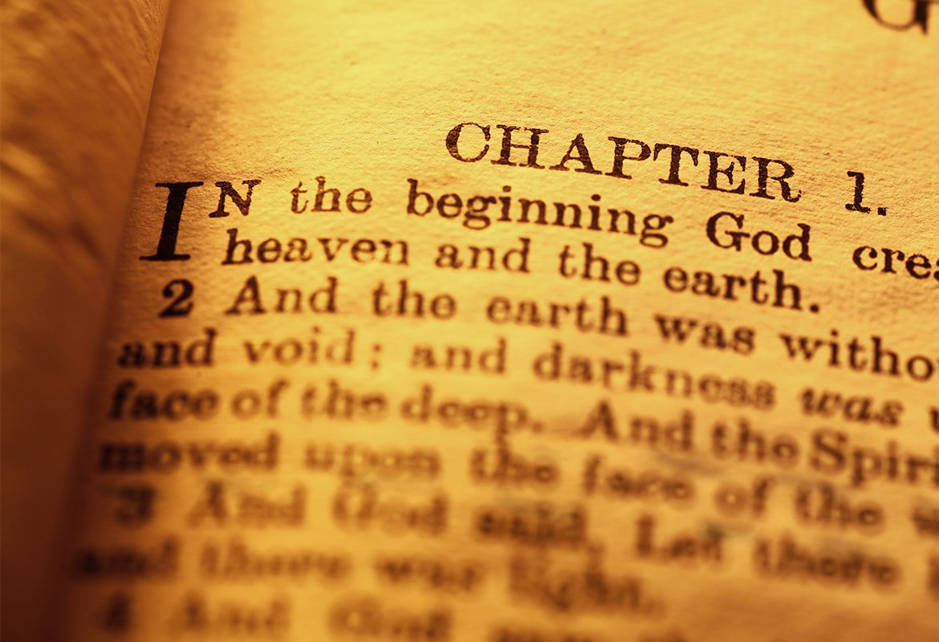
“Fit for the kingdom of god”
Luke 9:57-62

Slide 3
“FIT” For The Kingdom of God
“Well-placed, suited for, adapted to” A.T. Robertson
Colossians 1:13 “translated them in the kingdom of His dear Son”
Colossians 1:18 “[Christ] is the head of the body, the church”
NOT “FIT” with regard to nationality, color of skin, degree of prosperity or poverty, physical strength of weakness…
“FIT” or “UNFIT” regarding CHARACTER
“ARE YOU FIT FOR THE KINGDOM OF GOD?”
Luke 9:62 NKJV 62 But Jesus said to him, "No one, having put his hand to the plow, and looking back, is fit for the kingdom of God."

Slide 4
"No one, having put his hand to the plow”
8th Century B.C. “put ones hand to the plow” – signified undertaking of any business
“Anyone having obeyed the Gospel of Christ” – 2 Thessalonians 1:8
What is there to be obeyed?
John 8:24; Acts 17:30; Matthew 10:32; Acts 2:38; Romans 1:16
“Looking back”- lit. “Looking to the things behind”
Hebrews 12:2 “"looking unto Jesus, the author and finisher of our faith..."
Notes:
Man knows generally his physical location, but man needs to know his spiritual location so as to be rightly located!

Slide 5
"No one, having put his hand to the plow”
Overcome By Looking Back To:
Worldly Pleasures – 2 Thessalonians 2:12
Hebrews 11:25 “pleasures of sin for a season”
2 Timothy 3:1-5 “lovers of pleasure”
Worldly Riches – 1 Timothy 6:9,10
Luke 12:20,21 “’Fool! This night your soul will be required of you; then whose will those things be which you have provided?’”
Mark 10:23-27
1 Timothy 6:17-19
Notes:
Man knows generally his physical location, but man needs to know his spiritual location so as to be rightly located!

Slide 6
"No one, having put his hand to the plow”
Overcome By Looking Back To:
Worldly Cares – Luke 10:38-42
Not allow trivial affairs of this life to keep us from serving the Lord!
Matthew 6:33 “seek first the kingdom of God and His righteousness”
Do we really believe that the Bible is the inspired word of God?
Do we really believe that those who fail to comply with the will of God, will lose their souls in eternal torment?
Why do we find it so easy to neglect our duties toward him?
Notes:
Man knows generally his physical location, but man needs to know his spiritual location so as to be rightly located!

Slide 7
"FIT FOR THE KINGDOM OF GOD”
Ephesians 5:25-27 “He might present her to Himself a glorious church, not having spot or wrinkle or any such thing, but that she should be holy and without blemish.”
1 Corinthians 6:9,10, 11 – No place in the kingdom for those who insist on practicing sin!
Those who are “FIT” are totally committed to the Lord – not found making excuses for their failure to serve the Lord faithfully!
Once we put our hands to the plow, we should NEVER LOOK BACK!
Notes:
Man knows generally his physical location, but man needs to know his spiritual location so as to be rightly located!

Slide 8
Are You Fit For The Kingdom of God?
Outside of Christ MUST…
Hear the Gospel – Romans 10:17; Hebrews 11:6
Believe it – John 8:24
Repent of sin in your life – Acts 17:30
Confess that Christ is God’s Son – Matthew 10:34
Be baptized to wash away your sins – Acts 2:38
  An erring child of God MUST…
Repent and Pray for Forgiveness – 1 John 1:7-9
Christians MUST “be faithful unto death”
Revelation 2:10

